Slide 1
Goal / Objectives
Macro-view Trend Analysis (US vs Mid-Atlantic)
2. 5,000 SKU Selection via Statistical Approach
3. Analysis of categorical proportion in SKU Selection
4. Future Improvement & Strategical Planning

Slide 2
Analytical Strategy
With assumption of opening a new retail market in Mid-Atlantic area, 5,000 SKU must be selected based on the given datasets
In micro-scope view, general sales trend and categorical distribution in between US and Mid-Atlantic are relatively interchangeable
- To elaborate the concrete data analysis, the alternative approach by analyzing % change in sales on a quarterly/annual basis is more appropriate to use.
SKU selection method based on the Mid-Atlantic dataset except the competitive analysis between US and Mid-Atlantic
- Selecting SKU by benchmarking the items within Mid-Atlantic area is more effective way for localization and compatibility
SKU selection must be based on the proportionated SKU categorical distribution within Mid-Atlantic area
- incautious selection by % change in sales without considering categorical distribution can be problematic in both diversifying items and consumer’s satisfaction
Selected items’ sales performance should be sustainable and steady in sales growth rates as opposed to seasonal items that are relatively fluctuating in sales % change
- prioritize selecting SKU as stated above and find the strategical solutions by selecting seasonal items afterward to increase the sales and competitive advantage

Slide 3
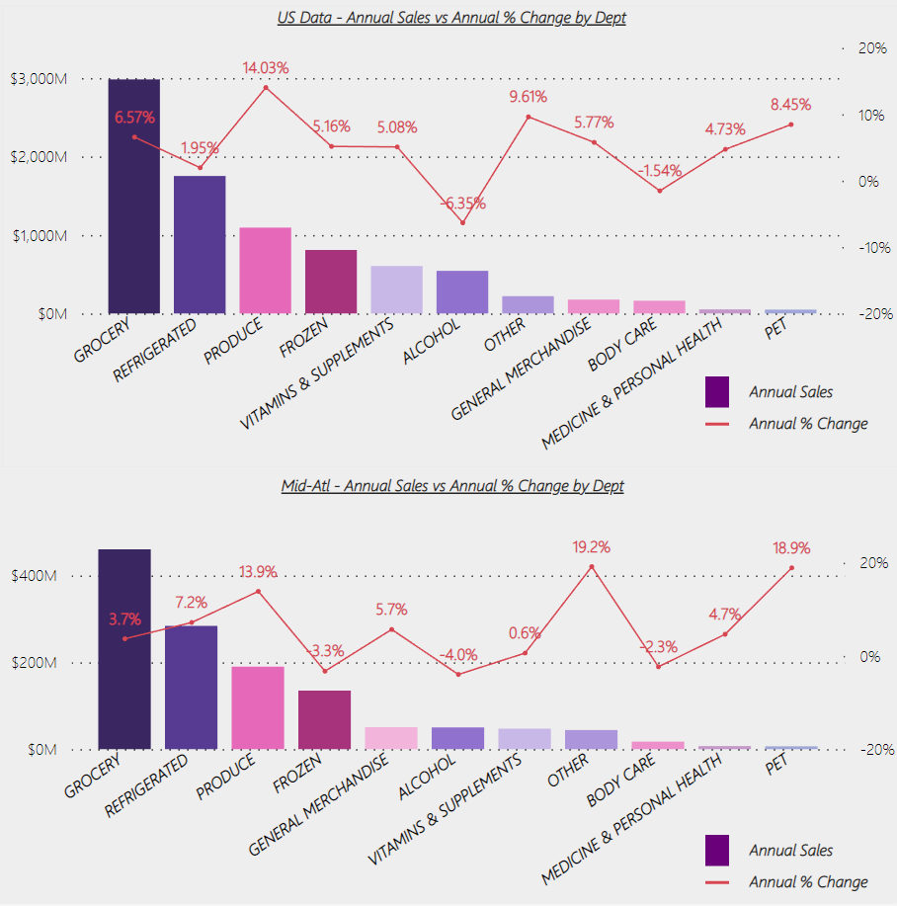
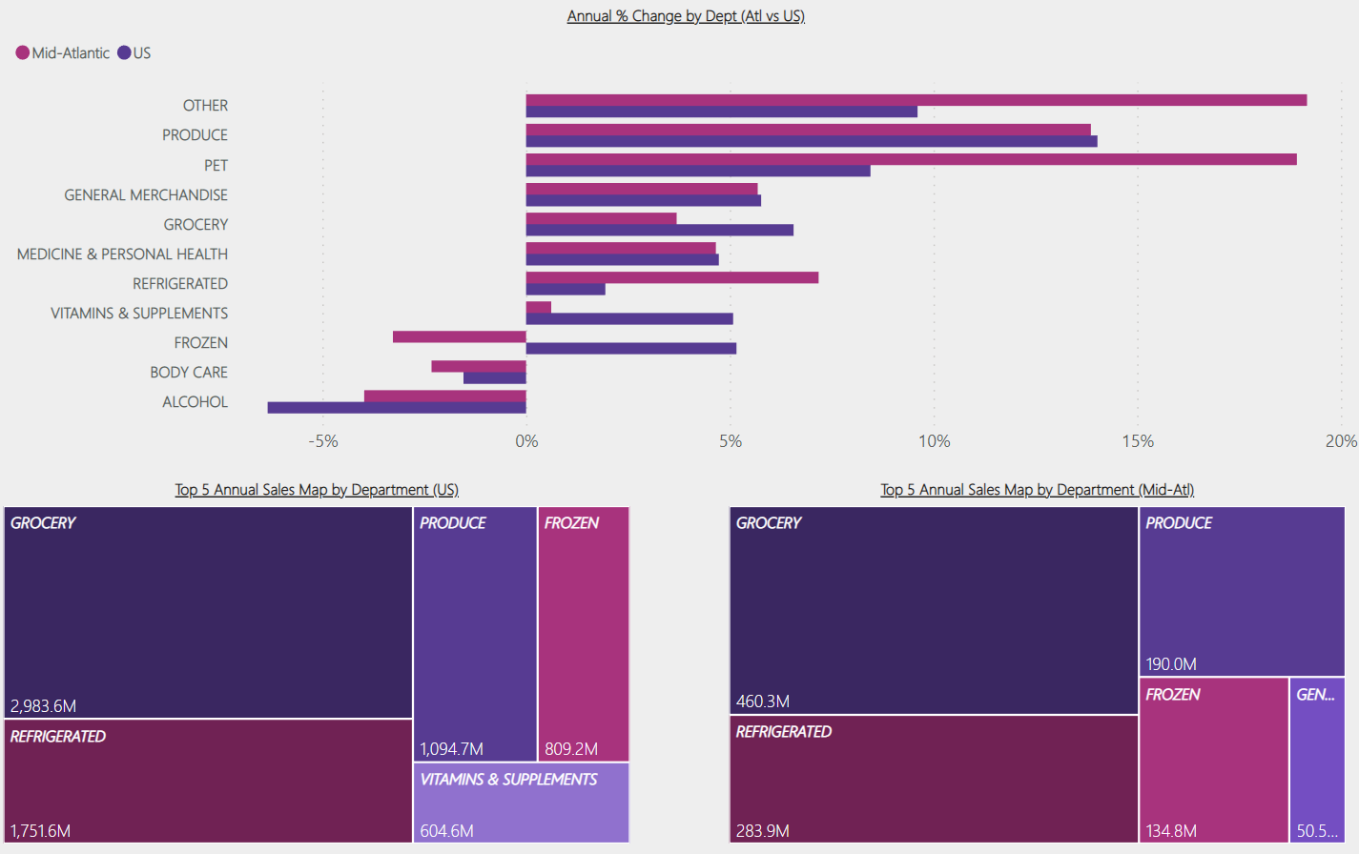
Macro-view Trend Analysis (US vs Mid-Atlantic)

Slide 4
Macro-view Trend Analysis (US vs Mid-Atlantic)
(Please see previous slide)
Comparing to US data, the scale and trend of annual sales are mostly going similar direction accordingly
Consumer’s preference in each category can be captured by annual sales % change year over year even if the general trend look similar
Customers in mid-Atlantic area prefer to buy refrigerated food than frozen food which is one of the best-selling categories in US data
The variation of customer’s item selection in mid-Atlantic area and consumer demand for refrigerated food are much higher than other US states where consumers have greater satisfaction in frozen food.
Drilling down to consumer demand in each item category, others in categorical sector has outperformed the annual sales amount in compared to the US-Index data, and it indicates that the spectrum of consumer’s item selection is much wider and relatively unpredictable (i.e. seasonal and localized items)
The primary goal is to maintain the standard of item diversification as it stands in the 10K mid-Atlantic data; however, the tactical consideration of targeting the refrigerated and others in categorical sector is needed for both the annual sales growth and consumer growth.

Slide 5
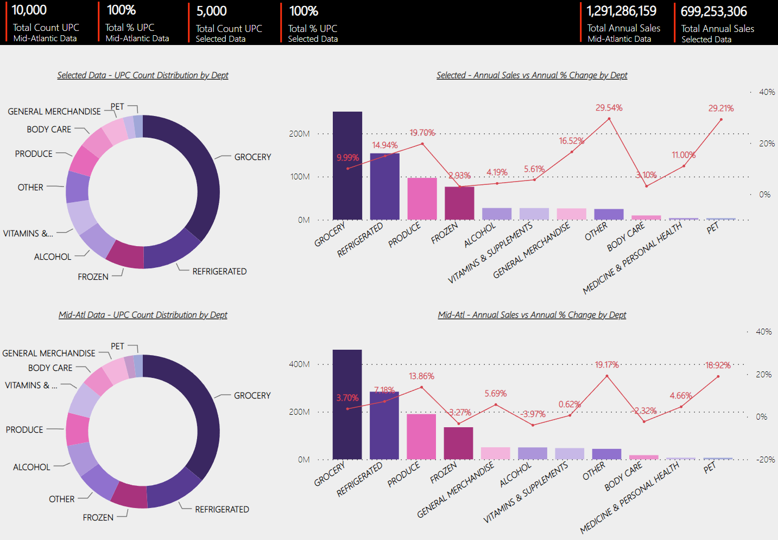
5,000 SKU Selection via Statistical Approach

Slide 6
5,000 SKU Selection via Statistical Approach
(Please see previous slide)
The primary goal is to land the new opening market with qualified localization and to benchmark mid-Atlantic data
The secondary goal is to sort out the item lists based on annual sales and and % change in annual sales on a quarterly basis, which are above 25% of minimum interquartile range
As a result of analyzing selected 4,988 SKU, annual % change of selected items in each category has outperformed in compared to the mid-Atlantic data.
The SKU proportion rate of selected items in each category is similar with mid-Atlantic data.
(Please see the next slide for the detail in regards to the statistical logic)

Slide 7
Analytical Technique
IQR (Interquartile Range) – First Phase
- Applied IQR techniques to each group of samples by department (upper level of unit category)
- Considering irregularity of the scales in different annual sales of each sample,
using a quartile by Annual Sales % change precisely is an effective way to remove samples below 25% of a quartile in each category
- Because it is difficult to filter serve size and feature of each item within the given amount of time, IQR can be viable to sort out the relatively inferior products even if there are similar items and maintain the level of categorical distribution.
- This technique could be limited to maximize the profit; however, it is flexibly compatible to provide diversification of item and to widen the range of item selection to the customers without violating skewed item listing in particular category
IQR (Interquartile Range) – Second Phase
- Maintained the theme of technique in general, but the second phase mainly focused on removing outliers
- Outliers in this phase had abnormal movement in quarter-to-quarter sales % change below or above IQR MIN/MAX value
- In this phase, the outliers, which have abnormal fluctuation in sales % change on a quarterly basis due to seasonal or unidentified factors, can be deleted among the filtered items in the first phase
- As an added logic, suspected items that seem to be newly listed at certain timeframe are not regarded as outlier
(Ex. Sales % change in 1Q-2Q was 0, but in 2Q-3Q, the sales % change suddenly popped up to 100%)

Slide 8
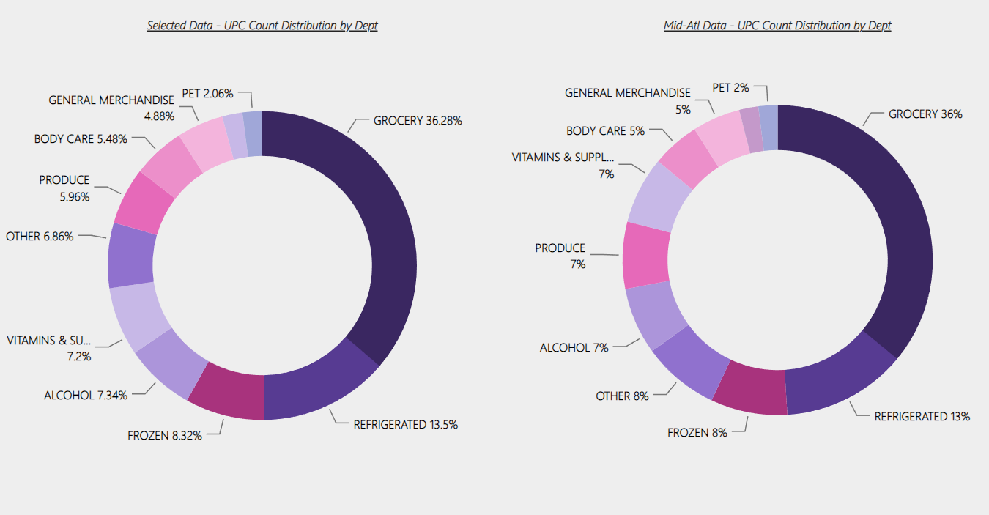
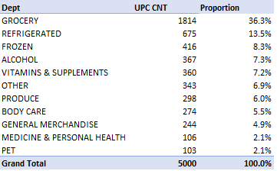
Analysis of categorical proportion in SKU Selection
Maintained the level of categorical distribution as similar as mid-Atlantic data as shown on the right
4,988 SKU items are selected based on the statistical techniques (please see the previous slide), and other 12 SKU items are selected based on the highest % change growth rate in 4Q/Q1, when the items are more likely to have the characteristics of seasonality with assumption to have a goal to increase the sales aggressively through making a difference by listing seasonal items
We can expect the effective sales growth and greater competitiveness through selecting relatively superior items, which are sustainable to make an impact on substantial growth in sales without violating the proportion of categorical distribution.

Slide 9
Future Improvement & Strategical Planning
There is a precise limitation that selecting items based on one-year period of data
→ Widen the time period and collect more data to analyze the result more intuitively and meaningfully
The process of elaborating the size and the characteristics of each items should be prioritized to analyze the output more accurately
For the scalability in the future, the data should be updated month to month through automating the statistical logics in use of advanced analytic tools such as Python and R
For the scalability in the future, the consideration of providing some buffer in range of 0.05 – 0.10 would be needed for targeted category as a tactical movement against competitors in the industry.
Deep dived research regarding seasonal items in advance is needed for planning out quarterly-based market strategy

